Slide 1
Scheme of Redemption

Slide 2
Goals of Our Study
To learn how God moved from man's problem of sin to His solution of Jesus on the cross
To understand how everything in the scriptures relates to, and points to, Jesus and the cross
To understand how everything in the Bible reveals God to mankind - who He is and what He is like
Get a better understanding of how we got here tonight on the orange carpet

Slide 3
Main concepts of our study
"Scheme of Redemption" - The plan of God, established before creation, to redeem mankind from sin
View the Bible as a novel, with 66 different chapters
The real division taking place at Genesis 3:6 rather than between Malachi and Matthew
This division covers two drastically different worlds: The world prior to sin and the world after sin

Slide 4
Main concepts of our study
Genesis 1-2: God and perfection, man and innocence
Genesis 3-12 – The Background of Redemption
Genesis 12-50 – Redemption through Abraham, Isaac, Jacob, and Joseph
Exodus 1-12 – Slavery In and Judgement On Egypt
Exodus 13-18 – Two Month Journey to Sinai

Slide 5
Recap
Discussed the 10th plague
Discussed the justness of God in the death of the firstborn of Egypt
God leading Egypt in a pillar of cloud by day and of fire by night
Pharaoh and his servants have a change of heart, realize they’ve lost their slaves, and go after Israel

Slide 6
Israel loses faith
Exodus 14:10-12 – As Pharaoh drew near, the sons of Israel looked, and behold, the Egyptians were marching after them, and they became very frightened; so the sons of Israel cried out to the Lord. Then they said to Moses, “Is it because there were no graves in Egypt that you have taken us away to die in the wilderness? Why have you dealt with us in this way, bringing us out of Egypt? Is this not the word that we spoke to you in Egypt, saying, 'Leave us alone that we may serve the Egyptians'? For it would have been better for us to serve the Egyptians than to die in the wilderness.”

Slide 7
Israel loses faith
Exodus 14:10-12 – As Pharaoh drew near, the sons of Israel looked, and behold, the Egyptians were marching after them, and they became very frightened; so the sons of Israel cried out to the Lord. Then they said to Moses, “Is it because there were no graves in Egypt that you have taken us away to die in the wilderness? Why have you dealt with us in this way, bringing us out of Egypt? Is this not the word that we spoke to you in Egypt, saying, 'Leave us alone that we may serve the Egyptians'? For it would have been better for us to serve the Egyptians than to die in the wilderness.”
Exodus 14:10-12 – As Pharaoh drew near, the sons of Israel looked, and behold, the Egyptians were marching after them, and they became very frightened; so the sons of Israel cried out to the Lord. Then they said to Moses, “Is it because there were no graves in Egypt that you have taken us away to die in the wilderness? Why have you dealt with us in this way, bringing us out of Egypt? Is this not the word that we spoke to you in Egypt, saying, 'Leave us alone that we may serve the Egyptians'? For it would have been better for us to serve the Egyptians than to die in the wilderness.”
Today
“It was better to be enslaved to sin than to be set free by God”
In other words:
“It would be better to be enslaved to Egypt than to be set free by God”

Slide 8
Israel loses faith
This will be an attitude that we will see played out over and over and over again with Israel
God’s power is shown, yet they still doubt, have fear, and long for Egypt again when seemingly bad things start happening
After all they had seen occur, shouldn’t they have now known that God was fighting and caring for them?
Are we any different??

Slide 9
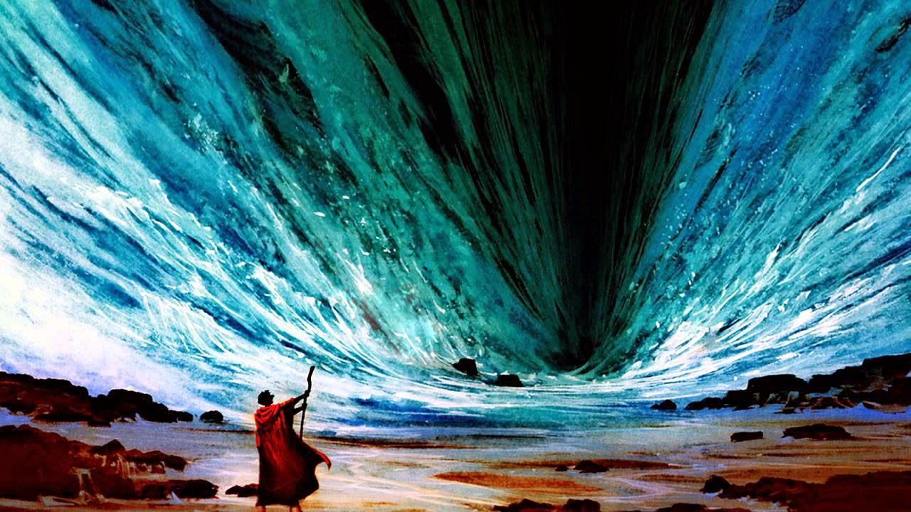

Slide 10
Parting of the Red Sea
Exodus 14:16-17 – “…lift up your staff and stretch out your hand over the sea and divide it, and the sons of Israel shall go through the midst of the sea on dry land. As for Me, behold, I will harden the hearts of the Egyptians so that they will go in after them”

Slide 11
Parting of the Red Sea
Exodus 14:21-23 – Then Moses stretched out his hand over the sea; and the Lord swept the sea back by a strong east wind all night and turned the sea into dry land, so the waters were divided. The sons of Israel went through the midst of the sea on the dry land, and the waters were like a wall to them on their right hand and on their left. Then the Egyptians took up the pursuit, and all Pharaoh’s horses, his chariots and his horsemen went in after them into the midst of the sea.

Slide 12
Parting of the Red Sea
Exodus 14:24-25 – At the morning watch, the Lord looked down on the army of the Egyptians through the pillar of fire and cloud and brought the army of the Egyptians into confusion. He caused their chariot wheels to swerve, and He made them drive with difficulty; so the Egyptians said, “Let us flee from Israel, for the Lord is fighting for them against the Egyptians”.

Slide 13
Parting of the Red Sea
14:26-28 – Then the Lord said to Moses, “Stretch out your hand over the sea so that the waters may come back over the Egyptians, over their chariots and their horsemen.” So Moses stretched out his hand over the sea, and the sea returned to its normal state at daybreak, while the Egyptians were fleeing right into it; then the Lord overthrew the Egyptians in the midst of the sea. The waters returned and covered the chariots and the horsemen, even Pharaoh’s entire army that had gone into the sea after them; not even one of them remained.

Slide 14
Parting of the Red Sea
14:30-31 – Thus the Lord saved Israel that day from the hand of the Egyptians, and Israel saw the Egyptians dead on the seashore. When Israel saw the great power which the Lord had used against the Egyptians, the people feared the Lord, and they believed in the Lord and in His servant Moses.
Yet, it won’t remain this way for long

Slide 15
Deepening of faith
In our study so far, we have seen faith grow and that faith motivates courage and change: e.g. Abraham, Joseph, Moses
However, we’ll not see the same with Israel. Even though Israel had seen God perform numerous powerful and undeniable works they still had much fear and doubt

Slide 16
Deepening of faith
Is our faith growing and maturing?
Are we recognizing the hand of God at work in our lives?
Is our faith rendering change, growth, and action in our lives? Are we taking that leap into the unknown KNOWING that God will provide?
Or do we, like Israel, continue to have doubt and fear that God won’t make good on His Word and His promises

Slide 17
God’s got this!!
Exodus 14:13-14 – But Moses said to the people, “Do not fear! Stand by and see the salvation of the Lord which He will accomplish for you today; for the Egyptians whom you have seen today, you will never see them again forever. The Lord will fight for you while you keep silent.

Slide 18
God’s got this!!
Exodus 14:13-14 – But Moses said to the people, “Do not fear! Stand by and see the salvation of the Lord which He will accomplish for you today; for the Egyptians whom you have seen today, you will never see them again forever. The Lord will fight for you while you keep silent.
The Lord will fight for you while you keep silent.
Should this also be a comfort to us?

Slide 19
God’s got this!!
James 1:2-4 – Consider it all joy, my brethren, when you encounter various trials, knowing that the testing of your faith produces endurance. And let endurance have its perfect result, so that you may be perfect and complete, lacking in nothing
What do learn here about faith and endurance?

Slide 20
God’s got this!!
James 1:5-8 – But if any of you lacks wisdom, let him ask of God, who gives to all generously and without reproach, and it will be given to him. But he must ask in faith without any doubting, for the one who doubts is like the surf of the sea, driven and tossed by the wind. For that man ought not to expect that he will receive anything from the Lord, being a double-minded man, unstable in all his ways.

Slide 21
Bad water turned good
Exodus 15:22-27
The waters of Marah were “bitter” and undrinkable, and there was much grumbling
God showed Moses a tree, which Moses then threw into the water, and the water became sweet

Slide 22
Bad water turned good
Exodus 15:25-26 – There He made for them a statute and regulation, and there He tested them. And He said, “If you will give earnest heed to the voice of the Lord your God, and do what is right in His sight, and give ear to His commandments, and keep all His statutes, I will put none of the diseases on you which I have put on the Egyptians; for I, the Lord, am your healer.”

Slide 23
The grumbling continues
Exodus 16:1-3 – Then they set out from Elim, and all the congregation of the sons of Israel came to the wilderness of Sin, which is between Elim and Sinai, on the fifteenth day of the second month after their departure from the land of Egypt. The whole congregation of the sons of Israel grumbled against Moses and Aaron in the wilderness. The sons of Israel said to them, “Would that we had died by the Lord’s hand in the land of Egypt, when we sat by the pots of meat, when we ate bread to the full; for you have brought us out into this wilderness to kill this whole assembly with hunger.”

Slide 24
Coming Up
Israel complains
God provides
Mt. Sinai
Ten Commandments given

